Slide 1

Statistical-Modelling-with-Python
Sarah Ajayi
5th June, 2023

Slide 2
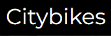



Project/Goals
Pull data from 3 API’s
Transform data
EDA
Visualization
Statistical Modelling

Slide 3
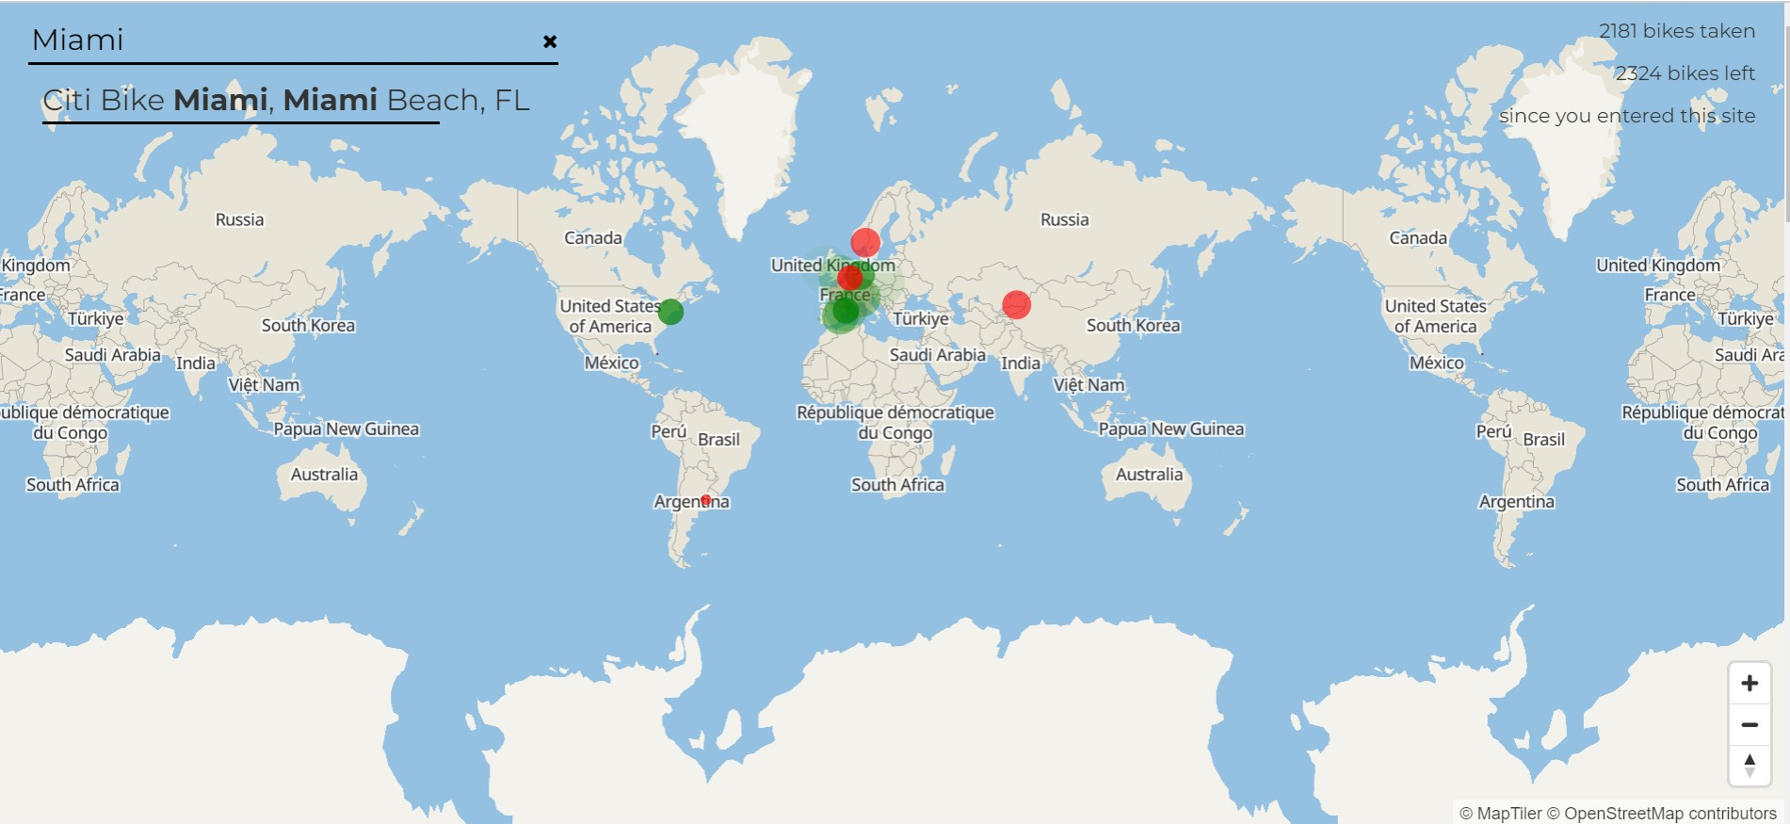

Miami Beach Florida

Slide 4
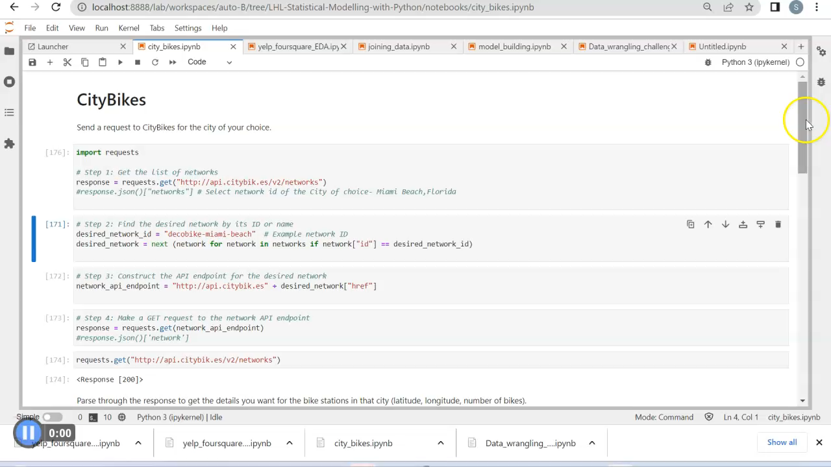
Notes:
Send a request to CityBikes for the city of your choice. Get desired info and parse into a Dataframe City’, CityLatLon’, Company’, Bike_Stations’, latitude’, longitude’, free_bikes’, empty_slots’ Save the DataFrame to a pickle file for future reference. samples_3_Miami_Bikes.to_pickle('samples_3_Miami_Bikes.pk')

Slide 5
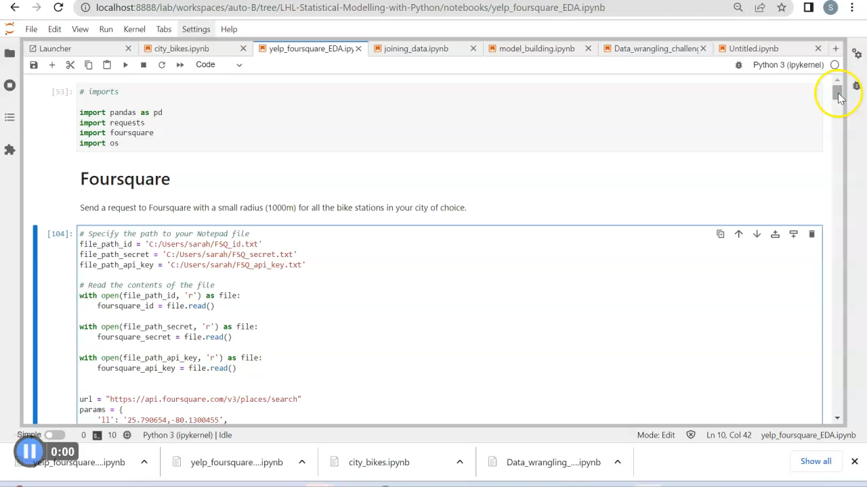

Slide 6
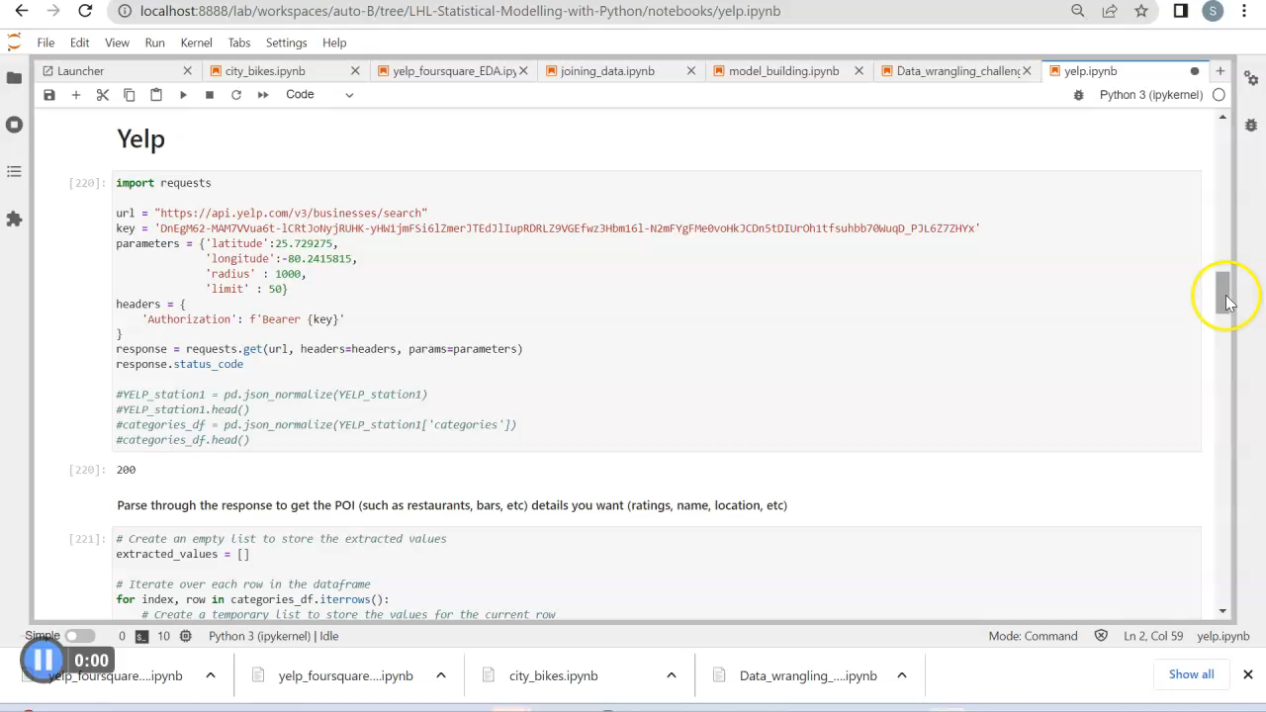

Slide 7
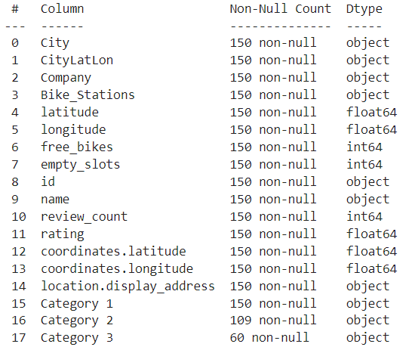
JOINING DATA -
CityBikes & Yelp
Stations(3 samples out of 163 records)
Florida Avenue
Aviation Avenue
City Hall

Slide 8
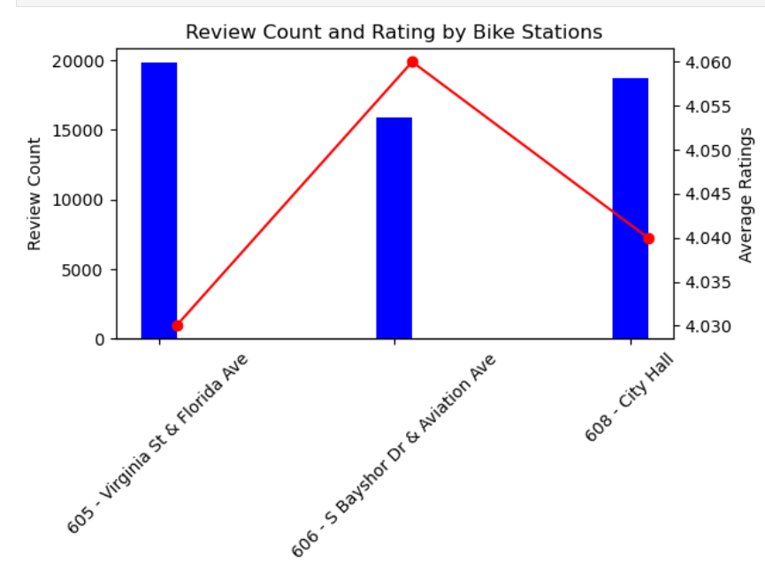
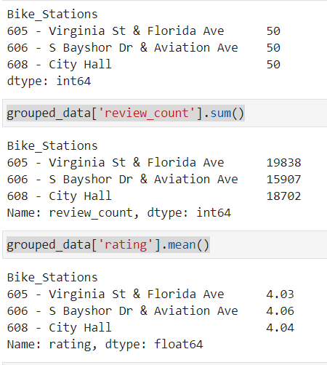
INSIGHTS

Slide 9
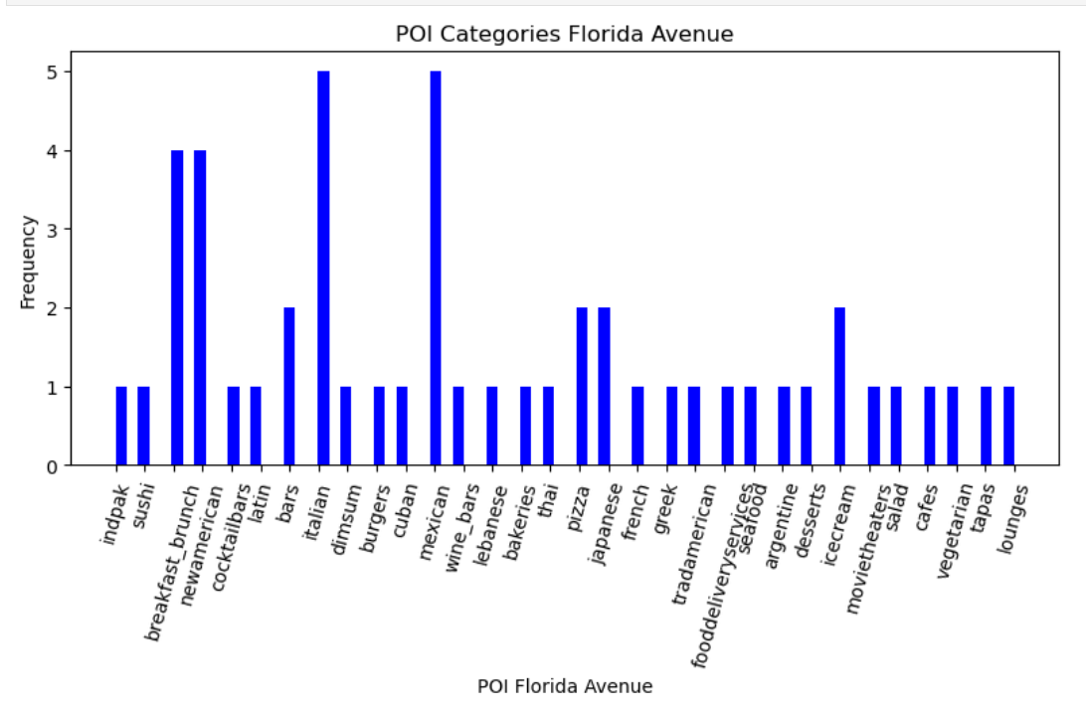
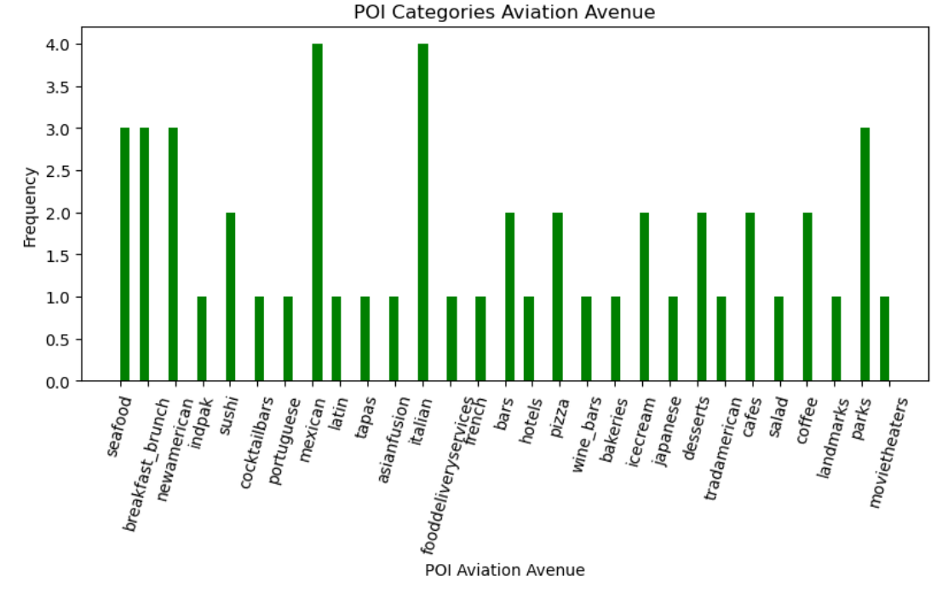
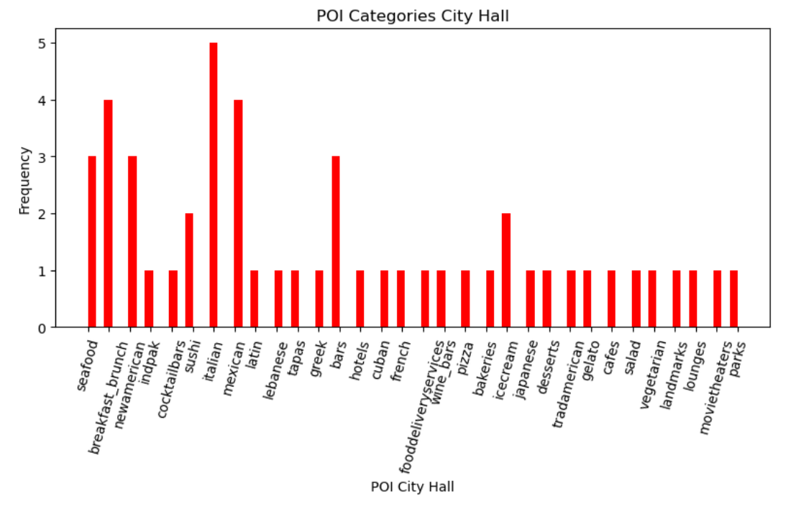

Slide 10
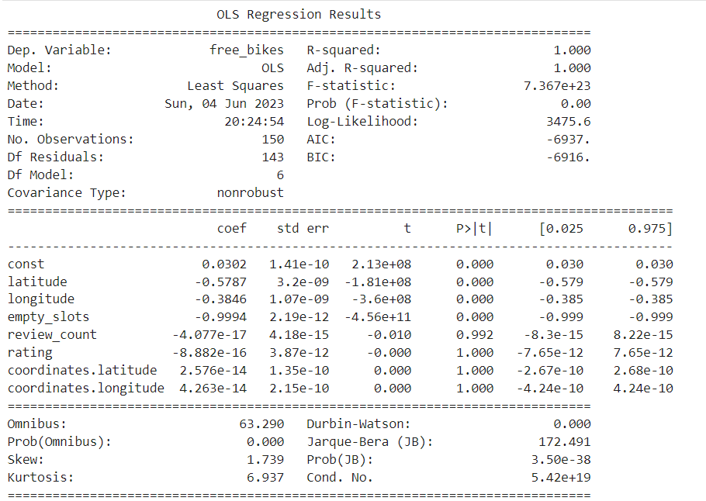
Model Building
Regresssion Statistical Models
Ordinary Least Squares (OLS)
The R-squared and Adjusted R-squared values measure the goodness of fit of the regression model.
A value of 1.000 suggests that the model explains all the variation in the dependent variable, which may indicate overfitting??? Few observations??
A p-value more than the chosen significance level - 0.05 suggests that the predictor variables – review count, rating,coordinates latlon has no significant effect on the dependent variable.
Backward Selection …..

Slide 11
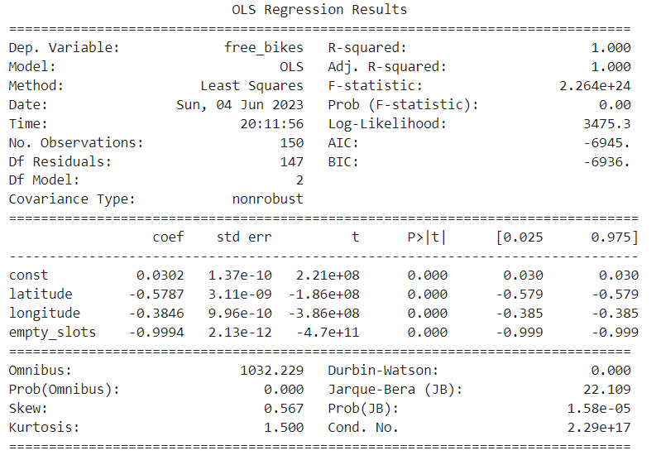
Backward Selection

Slide 12
Challenges
Poor API documentation
Issues with creating environmental variables
Iterating over different dataframe structures in the json file
Future Goals
Increase observations
De-categorize the POI for better granular insights
Classification Model

